Slide 1

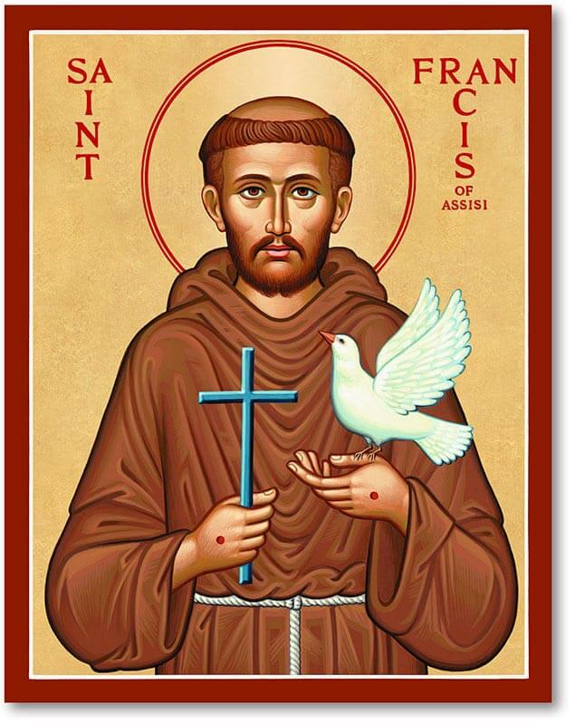
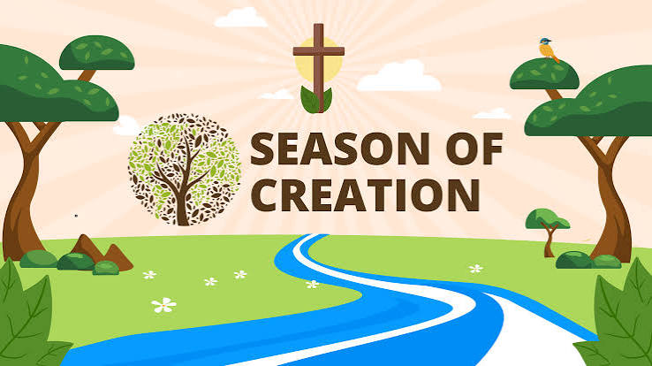
Autumn Term: Family and Community
Spring Term: Dignity of Work
Summer: Solidarity and the Common Good
Home Learning Project
Season of Creation Project
Due: 2nd October (Feast of St Francis of Assisi)
As part of the Season of Creation, we would like you to work with your child to
become a Guardian of Creation and celebrate God's wonderful world.
Reception Challenge:
Talk with your child about their favourite part of God's creation.
Go on a nature walk together and look for signs of God's creation.
Your family can present the project in any creative way you choose. We look forward to seeing your wonderful creations!

